Slide 1

Intro to Firmware development in
Use PyBadge as example development board w/ Rodeostat Featherwing
Many other devevelopment boards you can use
- over 517 on CircuitPython.org
- feather M4 Express, QtPy, Raspberry Pi Pico, Teensy 4.1, etc.

Slide 2

What are we going to cover?
PyBadge hardware overview
Setting up your board: installing bootloader & circuitpython
Basic development tools: editor/IDE, serial terminal, how to upload firmware
First programs: hello world, multiple source files, …
Talking to hardware. DigitalIO, AnalogIO, etc.
More development tools: libraries,the CircuitPython bundle and circup
Using buttons and display
Startup configuration: boot.py
Serial communications and writing files
Rodeostat Featherwing hardware and the Potentiostat class
Potentiostat examples

Slide 3
Slides and examples on github
https://github.com/iorodeo/circuitpython_tutorial

Slide 4
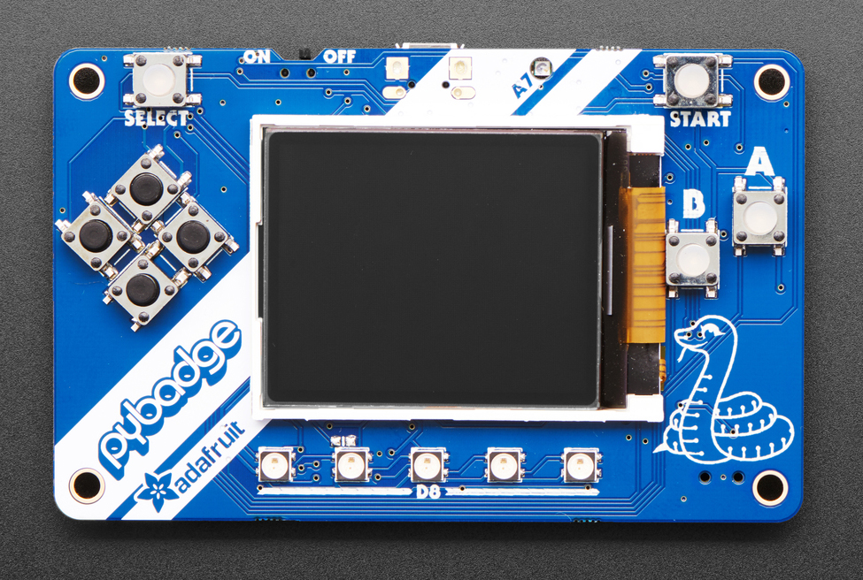
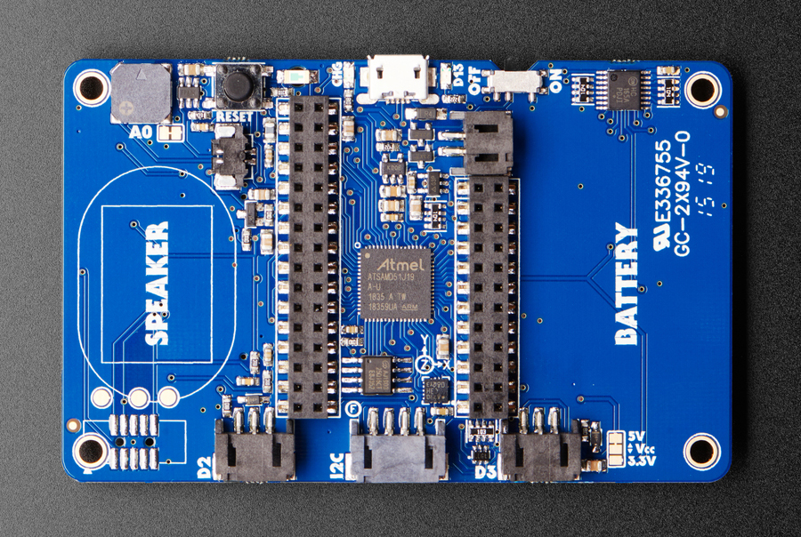
PyBadge hardware overview
MCU (ATSAMD51)
TFT display (160 x 128)
on/off
Reset
Battery connector
Buttons for user input
Featherwing headers
DigialIO, AnalogIO,
I2C connector
https://learn.adafruit.com/adafruit-pybadge/overview

Slide 5
PyBadge hardware overview
MCU ATSAMD51
- 3.3V, 120MHz
- 192KB of RAM
- 512KB of flash
2 MB of QSPI flash for file storage
13 GPIO (Digital input/outpus) D0, …, D13
8 Analog Inputs (ADC) A0, … A7
2 Analog Outputs (DAC) A0, A1
Serial buses: I2C, SPI, UART
8 user buttons
TFT Display 1.8”, 160x128, color
Other stuff: lipo charger, temp sensor, light sensor, accelerometer, neopixels
https://www.adafruit.com/product/4200
https://learn.adafruit.com/adafruit-pybadge/overview

Slide 6
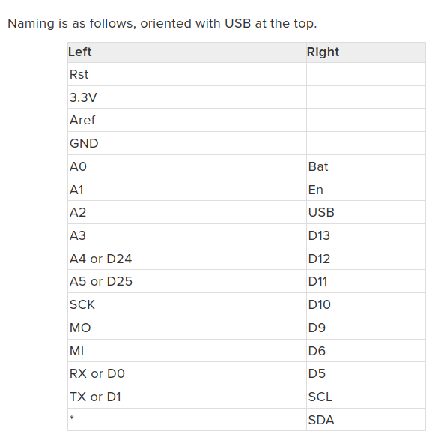
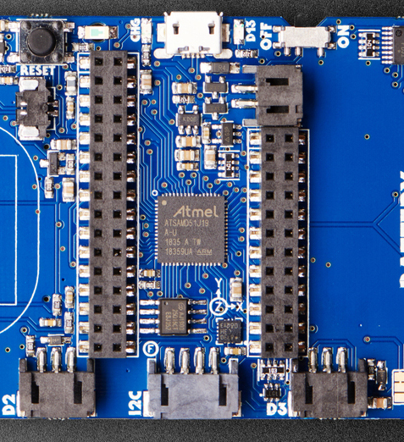
Feather header pinout

Slide 7
Installing/updating CircuitPython & bootloader
When connected via USB PyBadge will show up as drive called CIRCUITPYTHON
- CircuitPython is running
We want the uf2 boot drive to appear, called PYBADGEBOOT
- unmount/safely-remove drive
- double-click the RESET button
- a new drive will appear named PYBADGEBOOT
Get new bootloader and version of CircuitPython from circuitpython.org
- copy bootloader PYBADGEBOOT
- copy new circuitpython to PYBADGEBOOT
- CIRCUITPYTHON drive should reappear
https://learn.adafruit.com/adafruit-pybadge/installing-circuitpython

Slide 8
Basic development tools
Text editor/IDE for editing source code
- vscode, mu editor, vim, emacs, …
Serial monitor for debugging/exploration
- vscode plugin or mu editor
- tio, screen (linux)
- putty (windows)
Upload mechanism for moving source files from PC to PyBadge
- upload script: bash (linux), powershell (windows)-
- mu editor

Slide 9
Serial monitor and REPL
CTRL-C to stop currently running code and start REPL
CTRL-D to reload/restart code
help(‘modules’) to get list of built-in modules

Slide 10
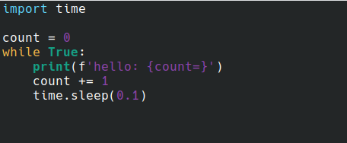
First Program: hello world
entry point is code.py
- on startup (or reset) looks for code.py and if found executes code in file

Slide 11

What if I accidentally corrupt the flash drive?
the usual symptom is that you are unable to write to the flash drive
can still access REPL through serial monitor
import storage and run erase_filesystem
Will need to reinstall project files, e.g. .py files, etc.

Slide 12
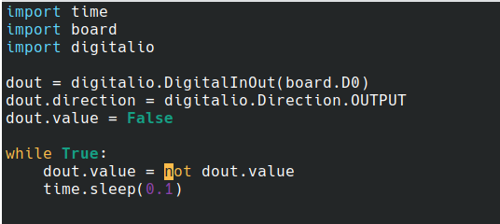
Talking to hardware: digitalio
using built-in modules: board, digitalio
set direction and value
digital input is similar
- set Direction to INPUT
- read .value

Slide 13
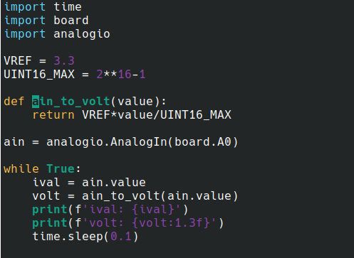
Talking to hardware: analogio
using built-in modules: board, analogio
set direction and value
Analog out is similar - use AnalogOut, set value instead of reading

Slide 14
More development tools
the CircuitPython bundle
- https://circuitpython.org/libraries
- https://github.com/adafruit/Adafruit_CircuitPython_Bundle
circup: a tool for managing circuitpython libraries
- download, update, create requirements.txt, etc.
- https://github.com/adafruit/circup

Slide 15
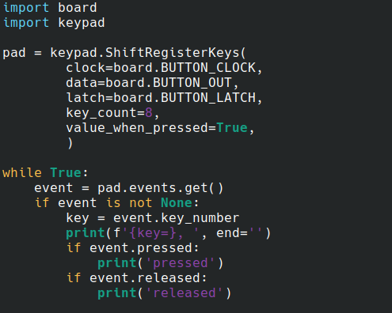
Using buttons
use keypad shift and look at events as they occur
https://learn.adafruit.com/key-pad-matrix-scanning-in-circuitpython/shiftregisterkeys

Slide 16
Using the display
Resources
https://learn.adafruit.com/circuitpython-display-support-using-displayio/introduction
https://docs.circuitpython.org/en/latest/shared-bindings/displayio/

Slide 17
Startup configuration
boot.py file is special
- executed when CircuitPython starts up via hard reset or powering up the board
- not run on soft reset e.g. reload from serial console/REPL
- can be used for configuration
Example CIRCUITPY drive
- by default read-write by host PC and read-only for CircuitPython
- can change so read-write for CircuitPython and read-only for host unless
users presses a button on startup

Slide 18
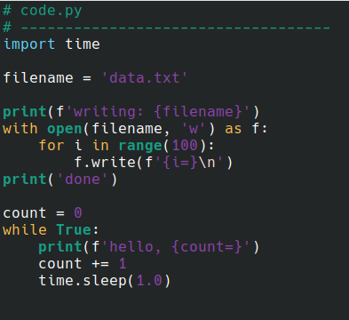
Writing files
CIRCUITPYTON drive needs to be mounted read-write (use boot.py )

Slide 19
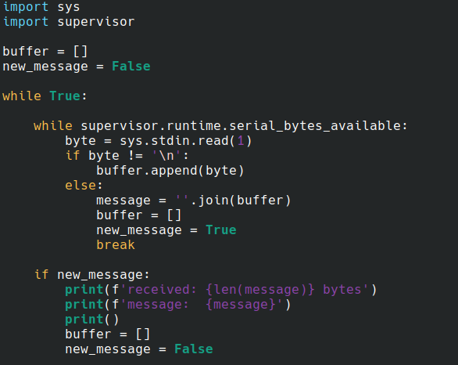
USB/Serial communications with host

Slide 20
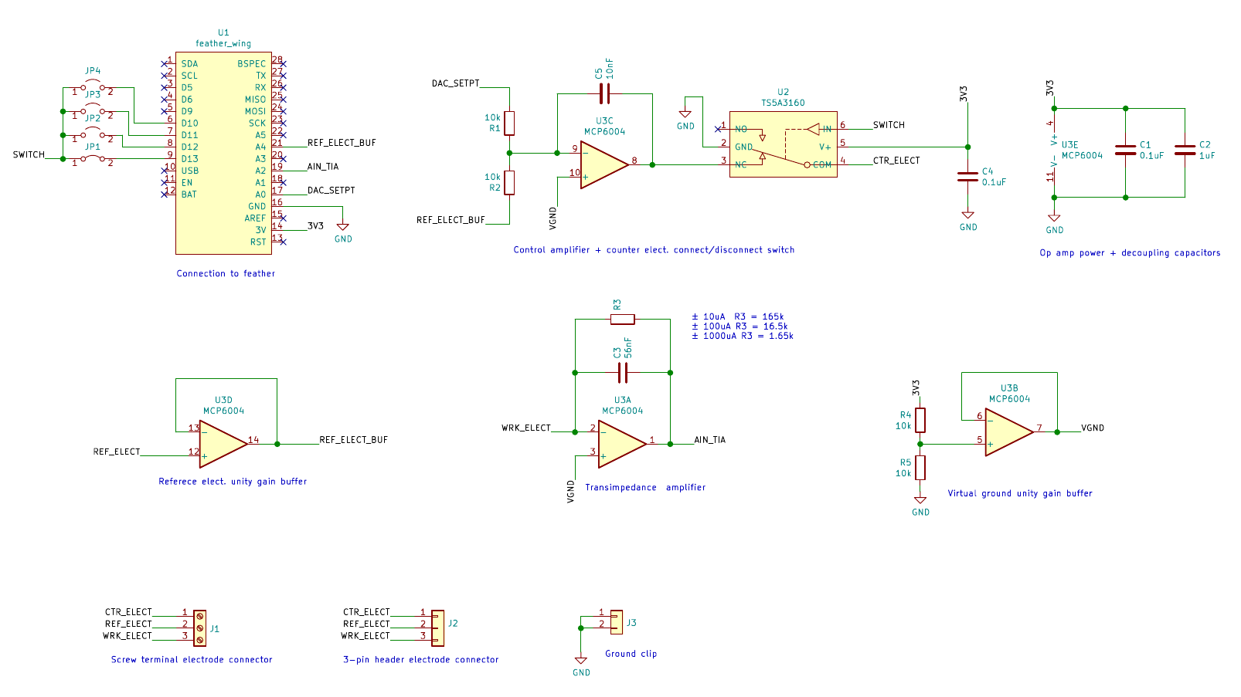
Rodeostat Featherwing hardware

Slide 21
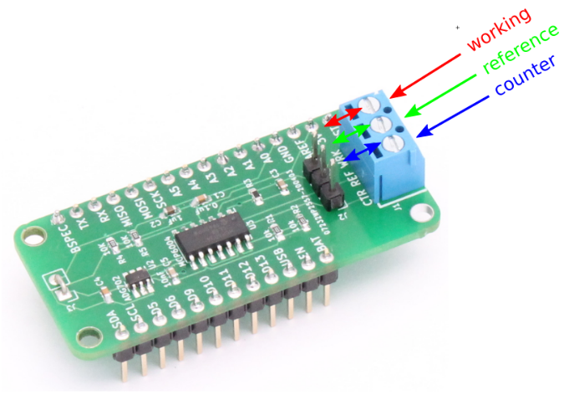
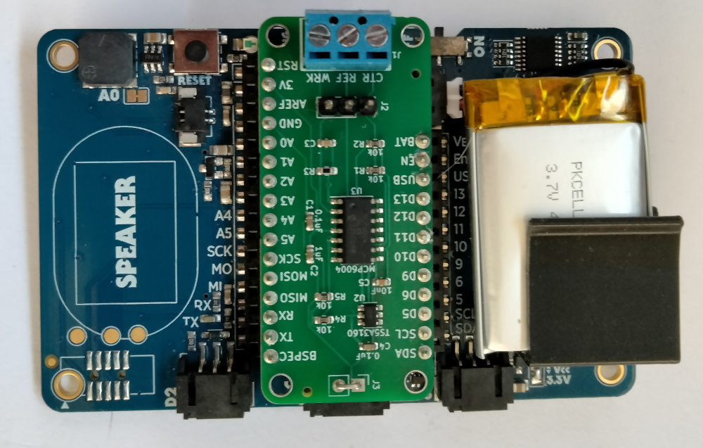
PyBadge and Rodeostat Featherwing
GND clip, 0V with respect to PyBadge not VGND
- for oscilloscope probes etc.

Slide 22
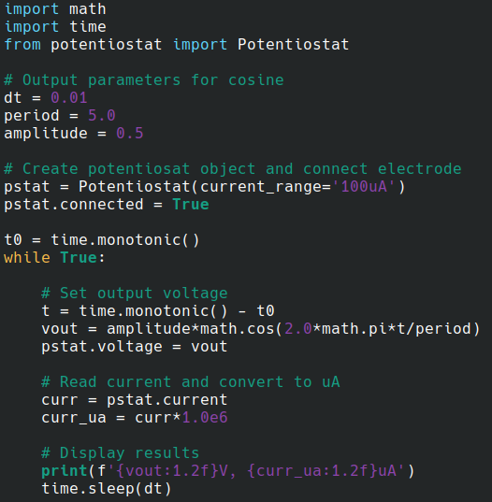
The Potentiostat class

Slide 23
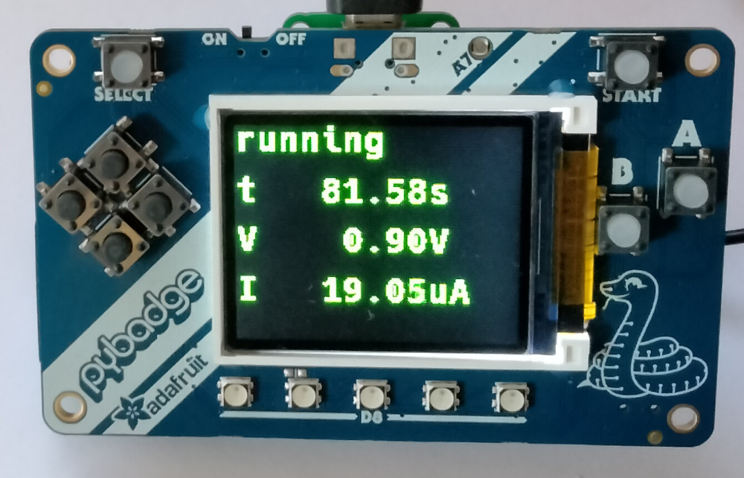
Potentiostat Examples
Cyclic voltammetry example with USB/serial between MCU and PC
- https://github.com/iorodeo/rodeostat_featherwing_example
Stand-alone constant voltage example displaying time, voltage and current

Slide 24
CirctuiPython Resources
https://circuitpython.org/
https://docs.circuitpython.org/en/latest/docs/index.html
https://github.com/todbot/circuitpython-tricks
https://circuitpython.org/awesome

